Slide 1
Lu string website presentation
Member:
Qing mu, ke Wang, Yue Teng, bokun li

Slide 2
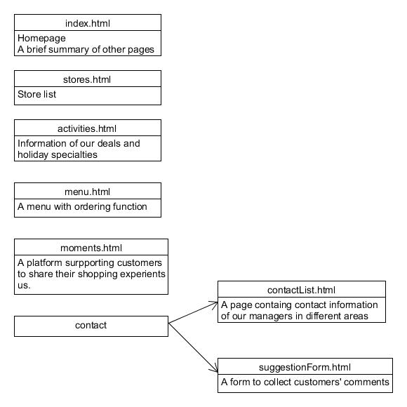
Website structure

Slide 3
Design idea
Objective: INCREASE the popularity of Chinese food
CATER FOR INCREASING ONLINE ORDERING REQUEST
FIT FOR MOBILE DEVICES
LANGUAGE: JAVASCRIPT( BOOTSTRAP JQUERY ANGULAR) HTML
Target group: youth

Slide 4
sCREENSHOTS

Slide 5
sCREENSHOTS

Slide 6
sCREENSHOTS

Slide 7
sCREENSHOTS

Slide 8
sCREENSHOTS

